Slide 1
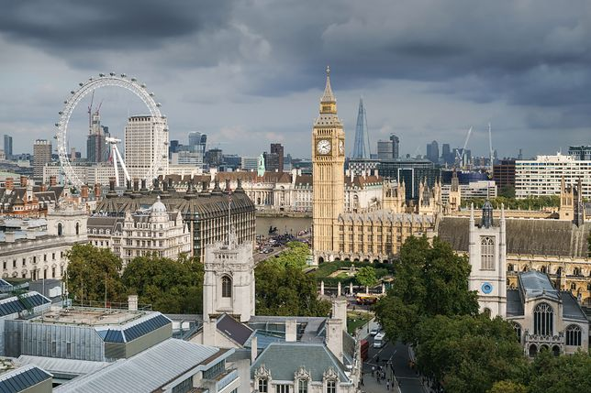

LONDON TOUR

Slide 2
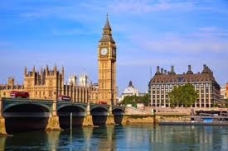
Look! There’s the Houses of Parliament and Big Ben. Most people in London think Big Ben is the name of the tower. But really it’s the name of the bell inside the tower. The bell is very loud. The Prime Minister and the government work in the Houses of Parliament.

Slide 3
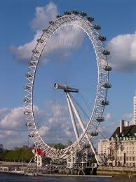
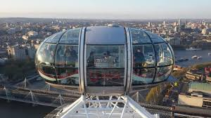
The London Eye is a big wheel. It’s 135 meters high. You can see all of London from the top.
You spend about 30 minutes in a special capsule.
It was opened in the year 2000

Slide 4
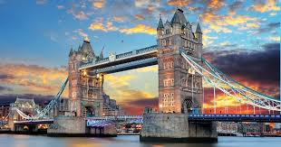
There are a lot of bridges over the River Thames in London. There are a lot of boats, too.
Tower Bridge is located in London,too. This is such a big bridge.

Slide 5
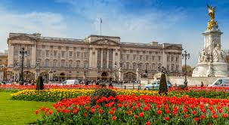
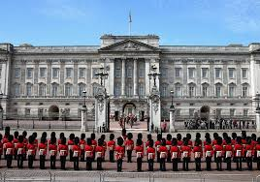
That’s Buckingham Palace .
The Queen lives there. It’s one of the most popular sights to see in London.

Slide 6
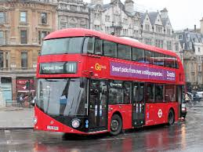
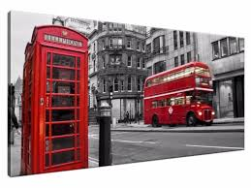
Red, double-decker buses are a symbol , not only of London, but of the whole Great Britain
Another characteristic symbol of Great Britain is the red telephone box. In the streets they first appeared in 1936.

Slide 7
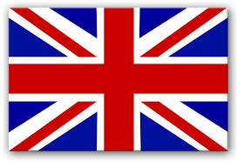
This is the end of the London tour

