Slide 1
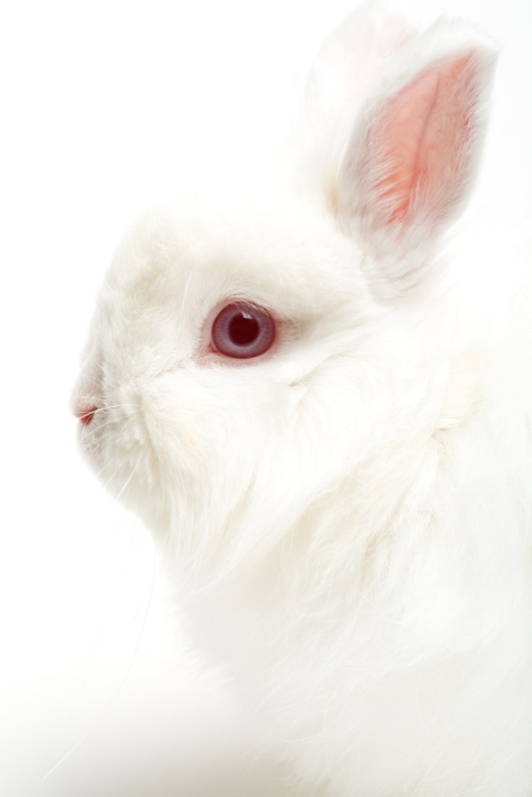
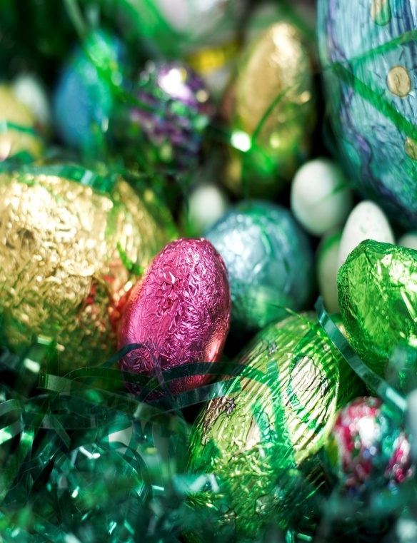
Easter

Slide 2
Easter-what is it ?
Easter-it is the oldest and the most important church holiday. This holiday commemorates rising from the dead of Jesus. During Easter people bless Easter baskets.
Notes:
najstarsze i najważniejsze święto chrześcijańskie upamiętniające zmartwychwstanie Jezusa Chrystusa^{[2]}, obchodzone przez Kościołychrześcijańskie wyznające Nicejskie Credo (325 r.).

Slide 3
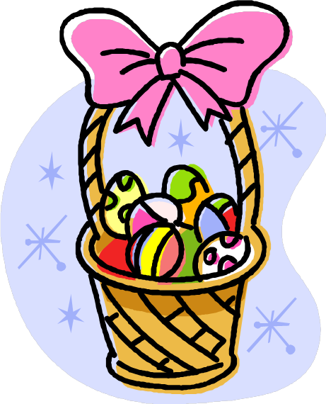
Easter
GOOD FRIDAY
GREAT SATURDAY
GREAT SUNDAY

Slide 4
E is for Easter, coming soon,
A is for angels near the tomb,
S is for stone which was rolled away,
T is for tomb found empty that day,
E is for early morning, the women are glad,
R is for the Risen Lord, no need to be sad.

Slide 5


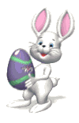

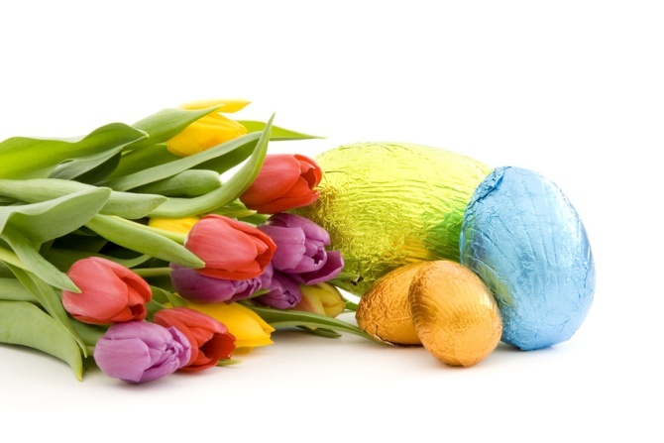
Easter traditions
Painting eggs
Blessing Easter baskets
Egg hunting
A holiday cleaning
Easter Monday
Good Friday
Great Saturday
Easter Sunday
Egg rolling

Slide 6
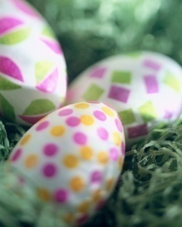

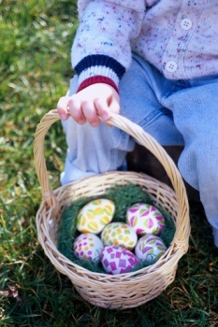
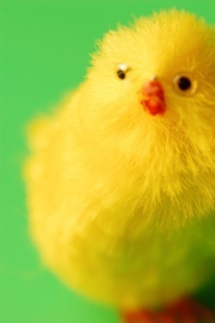
Easter symbols
Easter-eggs Chocolate Bunny
Easter lamb Easter basket
Chick Catkins
Ribbon Borscht

Slide 7
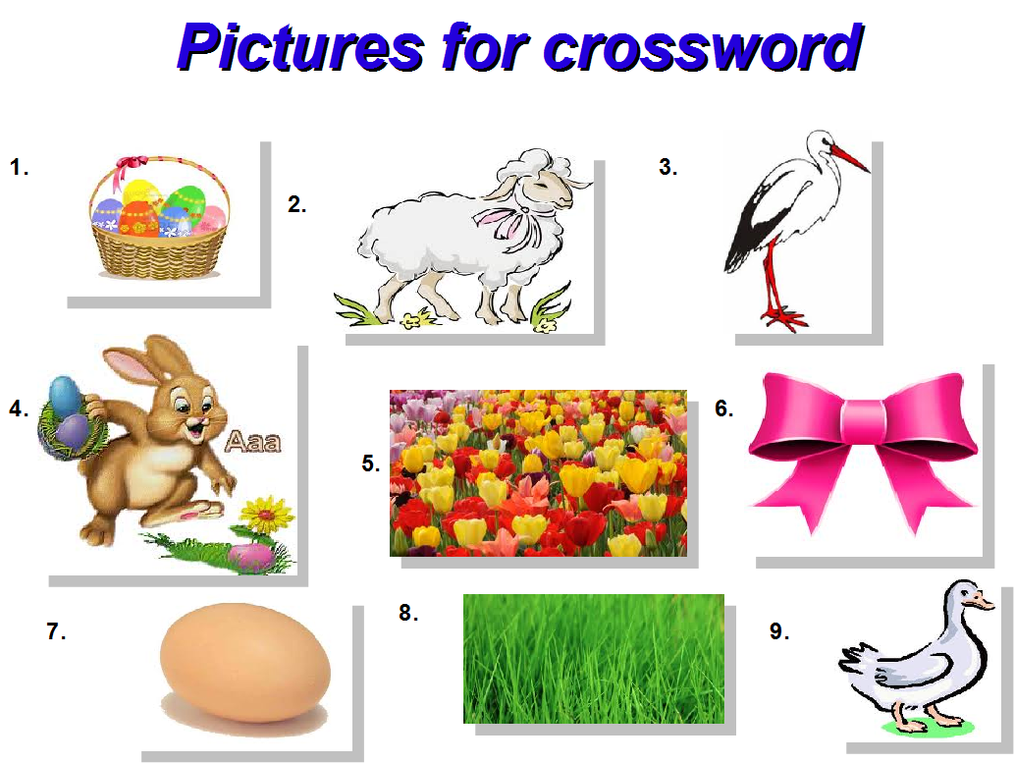
Hiding Easter Eggs
Hello there! This time I'll suggest the places to hide Easter Eggs. I wrote here the simplest places to hide Easter Eggs because there is an infinity of places to hide them.
Inside
Behide a small object (like a flowerpot, some decorations, etc.)
Under the bed/pillow
In the toilet paper
In the „sock” of the telephone
On the shelf
Between bookshelves/chests of drawers
In the mug

Slide 8
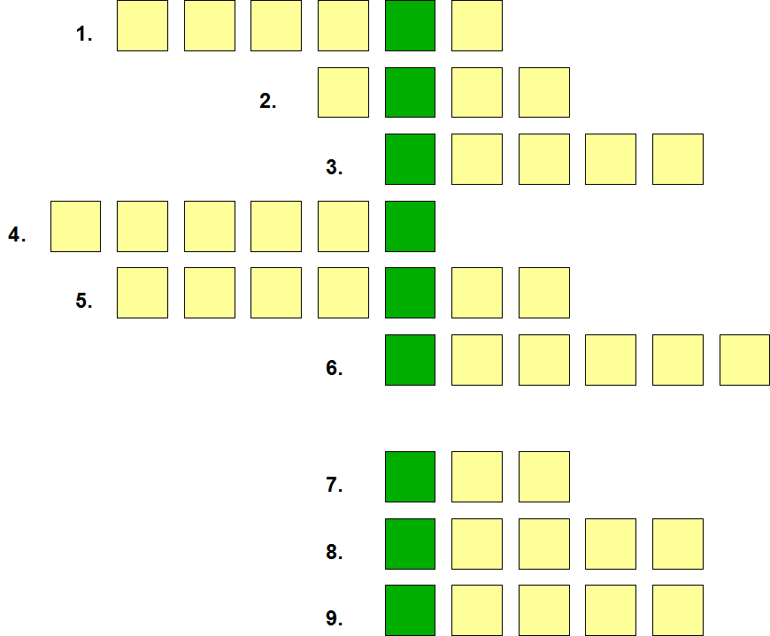

Slide 9
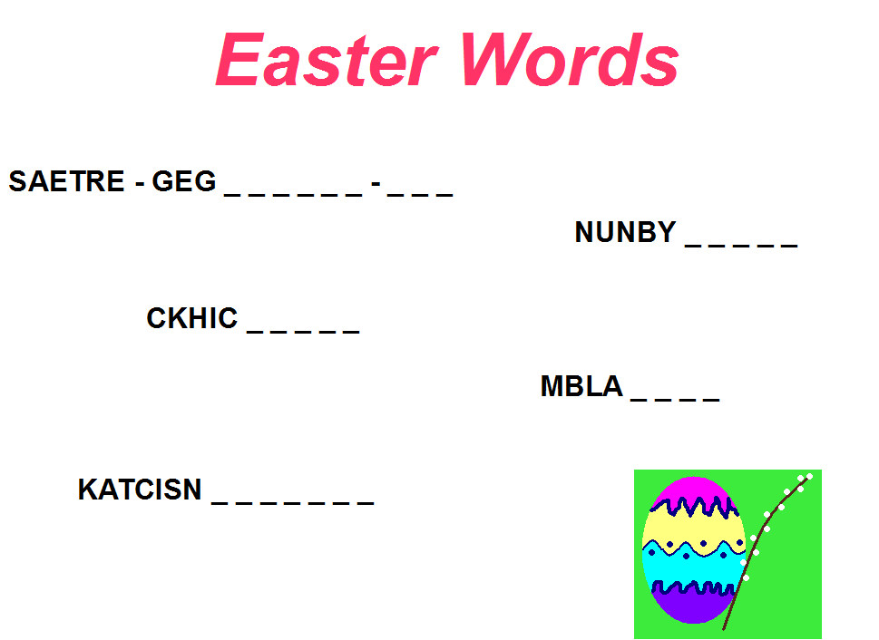
Hiding Easter Eggs
Outside
In the hollow of the tree
Dug under the ground (mark this place)
Hidden in the tall grass
In the bucket
Behind the plants (like tomatoes)
Under the twigs
Behind the flowers

Slide 10
As spring comes to the world, bringing sunshine and gladness......
this comes to you bringing wishes for joy.
Happy Easter

Slide 11

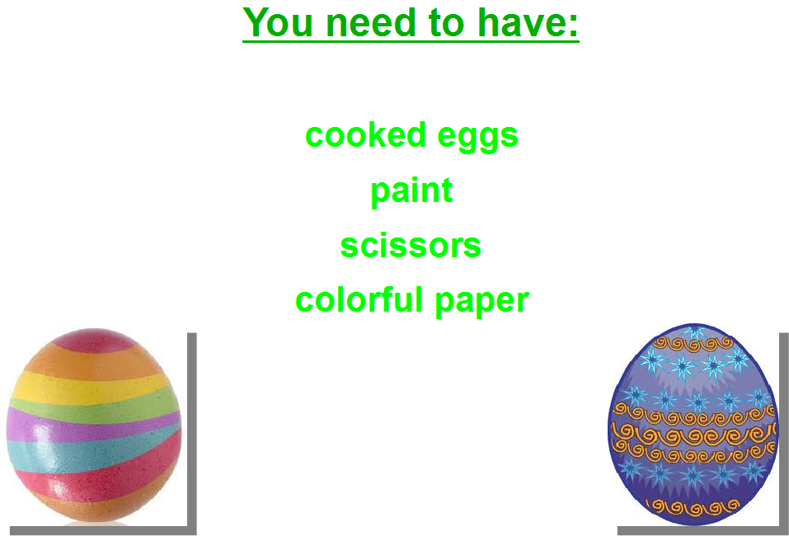

Slide 12
Hiding Easter Eggs
Hello there! This time I'll suggest the places to hide Easter Eggs. I wrote here the simplest places to hide Easter Eggs because there is an infinity of places to hide them.
Inside
Behinde a small object (like a flowerpot, some decorations, etc.)
Under the bed/pillow
In the toilet paper
In the „sock” of the telephone
On the shelf
Between bookshelves/chests of drawers
In the mug

Slide 13
Outside
In the hollow of the tree
Dug under the ground (mark this place)
Hidden in the tall grass
In the bucket
Behind the plants (like tomatoes)
Under the twigs
Behind the flowers

Slide 14
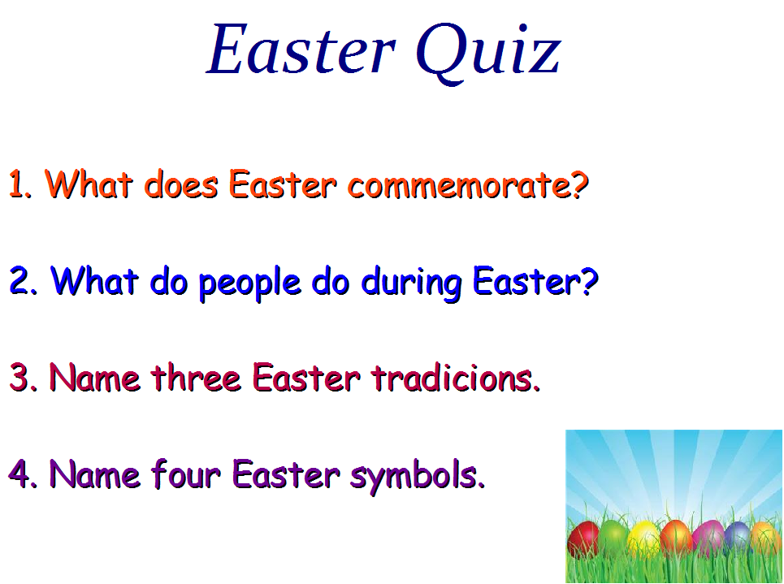
t

Slide 15
The End
Prepared by :Kacper Kopycki , Julka Dyba , Adrian Kunikowski , Agnieszka Witasik , Agata Urbańczyk.

